Slide 1
ECONOMIC GEOGRAPHY & DEVELOPMENT
Unit 2 Lesson 4
Levels of Development

Slide 2
The Ripple Effect
If there were a power failure in your community, how might that affect you?
How might that blackout in your community affect neighboring communities?

Slide 3
Map Items on SIM
Australia
Canada
New Zealand
United States
Western Europe
Japan
Argentina
Brazil
China
Eastern Europe
India
Mexico
Russia
South Africa
Venezuela
Afghanistan
Africa (minus South Africa)
Columbia
Cuba
Haiti
Iran
Iraq
Mongolia
North Korea
Pakistan
Peru
Southeast Asia

Slide 4
Essential ?’s
What is the spatial relationship between the core, semi-periphery, & periphery countries?
Is it possible to move from being a country on the periphery to becoming more in the semi-periphery or even the core? Why/Why Not?
Get Ready 4 Vocabulary ☺

Slide 5
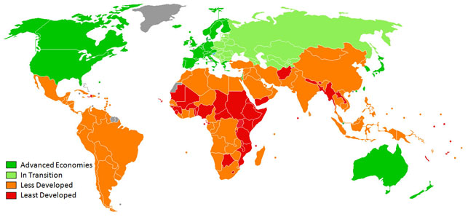
Level of Development
Determined by:
GDP
Access to technology
Literacy rates
# of doctors & Life Expectancy
Birth rate & Infant Mortality rates
Types of Jobs

Slide 6
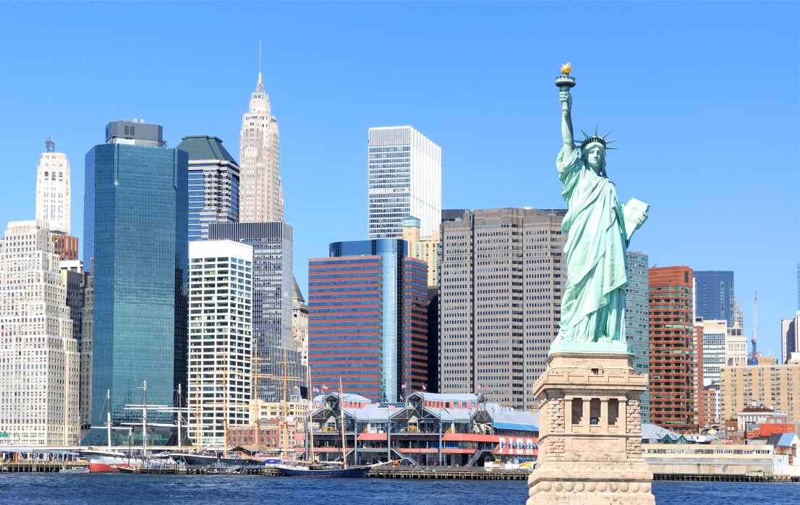
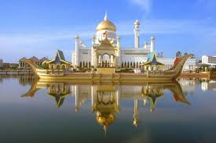
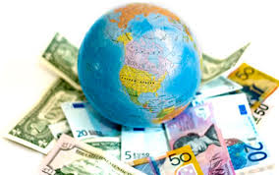
Core Countries
The leading developed countries that depend on the resources and cheap labor from the semi-periphery & periphery countries.
High GDP & Literacy Rates
Longer Life Expectancy & Infrastructure
Greater Access to Technology
Deindustrialized

Slide 7
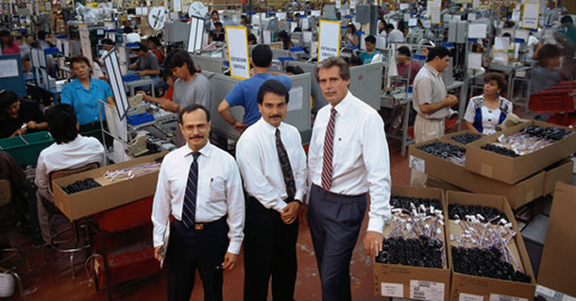
Semi-periphery Countries
Newly industrialized countries that are developing & may not have a stable economy but continue to thrive.
Strong trading relationship with developed Core countries
Depend on investment capital from Core
Outsourced & Maquiladoras

Slide 8
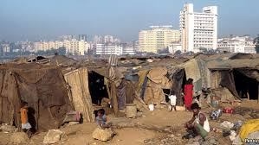
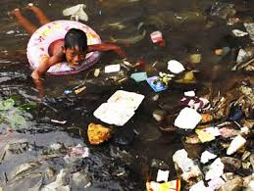
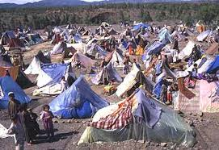
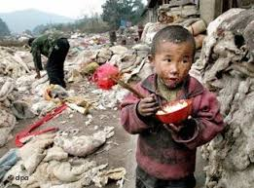
Periphery Countries
Less developed non-industrialized countries with little or no infrastructure
Low Standard of Living
High Poverty
Lack of clean water & electricity

Slide 9
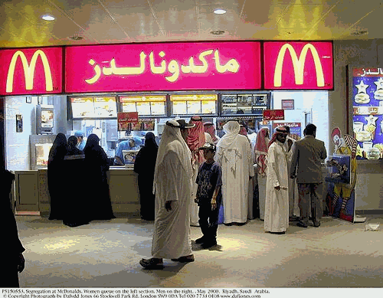
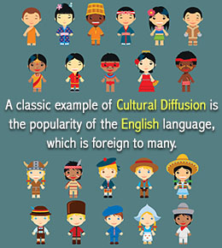
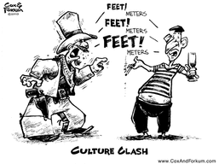
Diffused
To spread over a wide area or a large # of people.
Culture
Ideas
Technology
Language
Religion
Government
Commerce

Slide 10
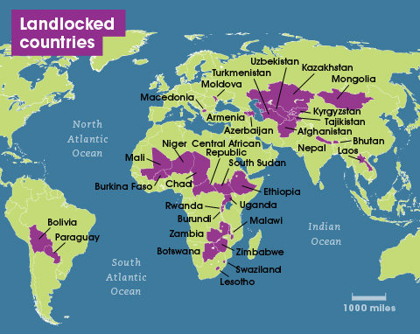
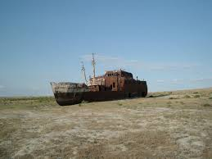
Landlocked
NO access to the coastline or seaport, surrounded by land.
Difficulty trading with other countries.

Slide 11
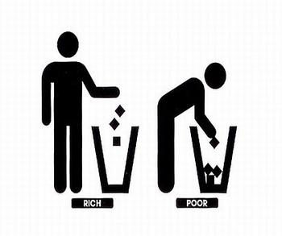
Complete IR-14 & IR-16/17
Using the Reading from IR-15
This is NOT group work
If you have any ?’s Please raise your hand ☺

Slide 12
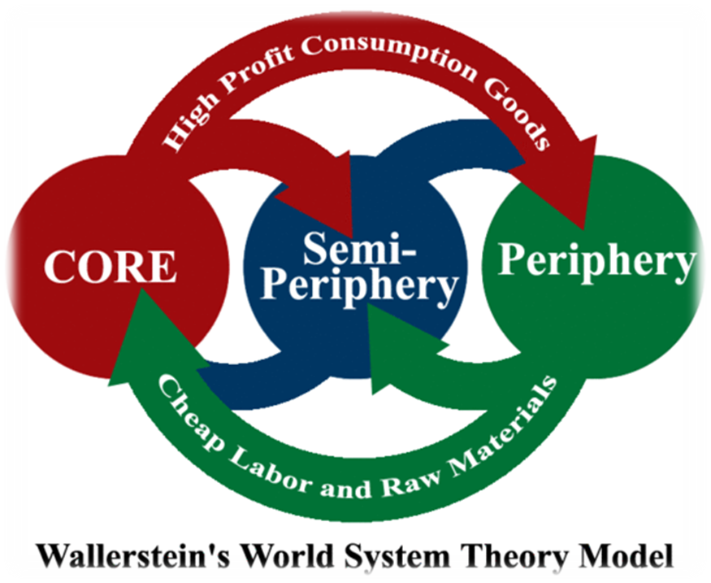
Geographer Journal Writing
You are an ambassador from a country that was discussed in the categories described in Wallerstein’s world systems theory. Write a list of talking points you will use in a speech to other countries not in your category, proving to them that it is better for your country to be at its current level of development. The speech will be given at an international conference on global economic development.

