Slide 1
Factors of Production

Slide 2
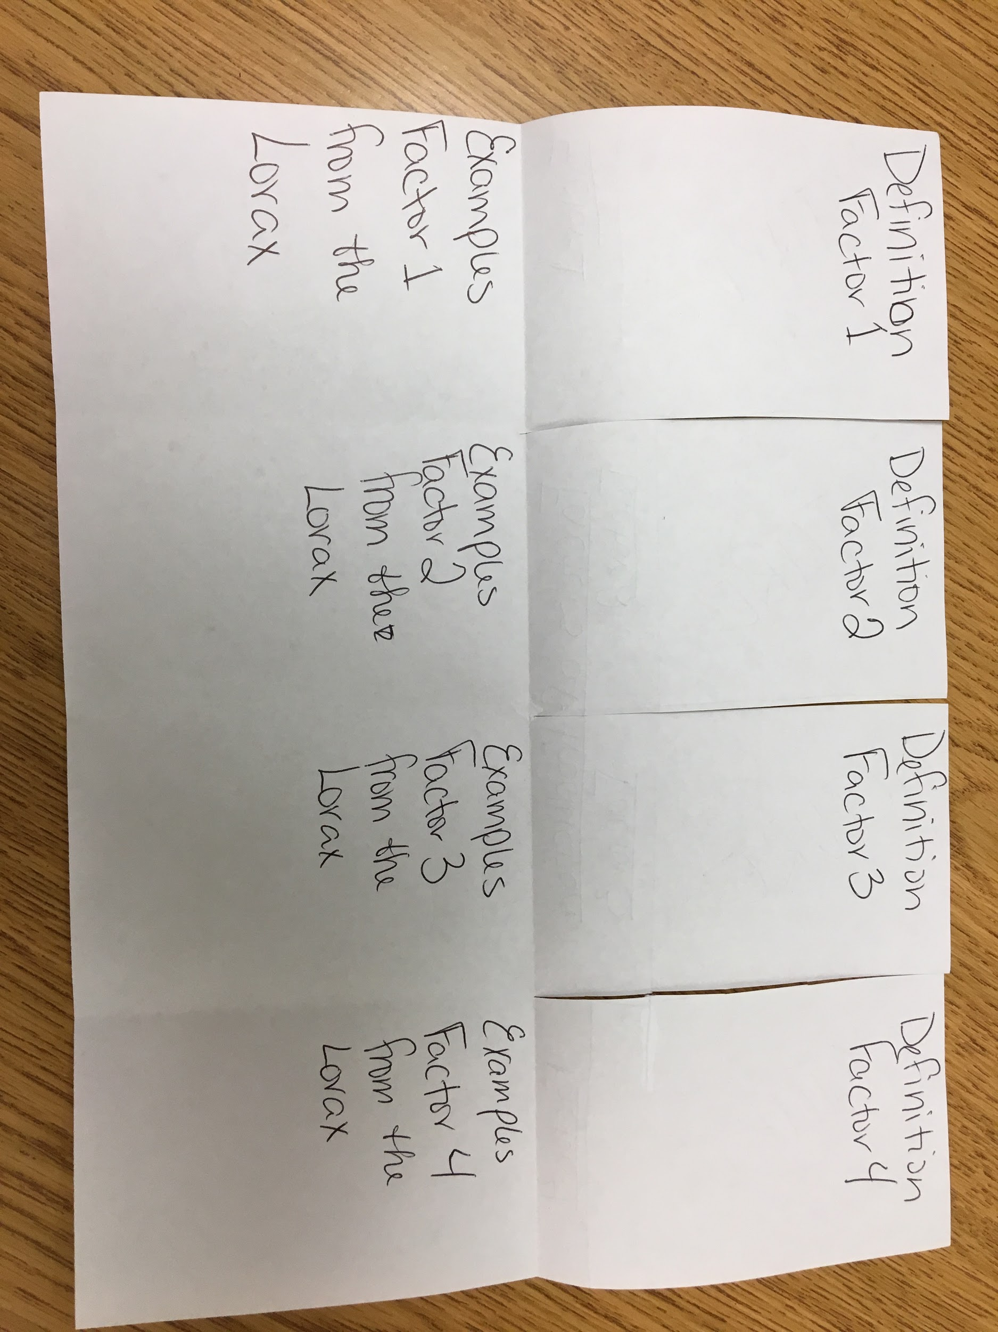
Foldable with 4 Factors of Production
Fold paper lengthwise, to create 2 long halves
Fold this into 4 sections
Create 4 Tabs, 1 for each factor
Each tab should have a factor of production and a picture to represent the factor
When opened the top of each tab should have a good definition for the factor and then the bottom should be left as space to write examples of the factor from the Lorax movie clip.

