Slide 1
Political Geography & Globalization
Unit 6 Lesson 3
Diffusion of Democracy and Communism

Slide 2
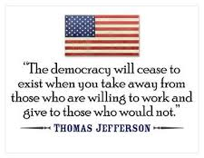
Essential ?’s
What groups of people and/or countries created or modified democracy from its origin to present day?
What groups of people and/or countries created or modified communism from its origin to present day?

Slide 3
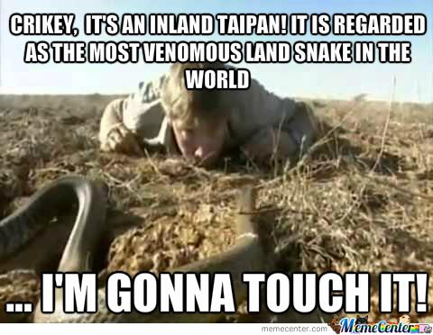
Map Items on SIM
Athens
Moscow
Cuba
England
United States
Scotland
Germany
Soviet Union
China
North Korea
Vietnam

Slide 4
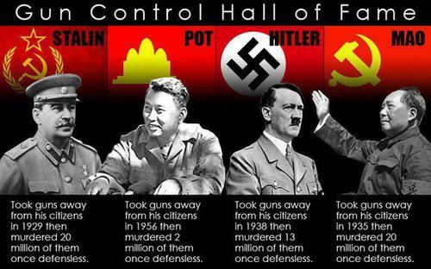
Vocabulary
Republic – is a state in which the ultimate and final authority of the land is determined by representatives who are lawfully elected by the people and whose job it is to represent the people.
Czar – ruler of Russia
Dictatorship - a country, government, or the form of government in which absolute power is exercised by a dictator
Russia
Cambodia
Germany
China

Slide 5
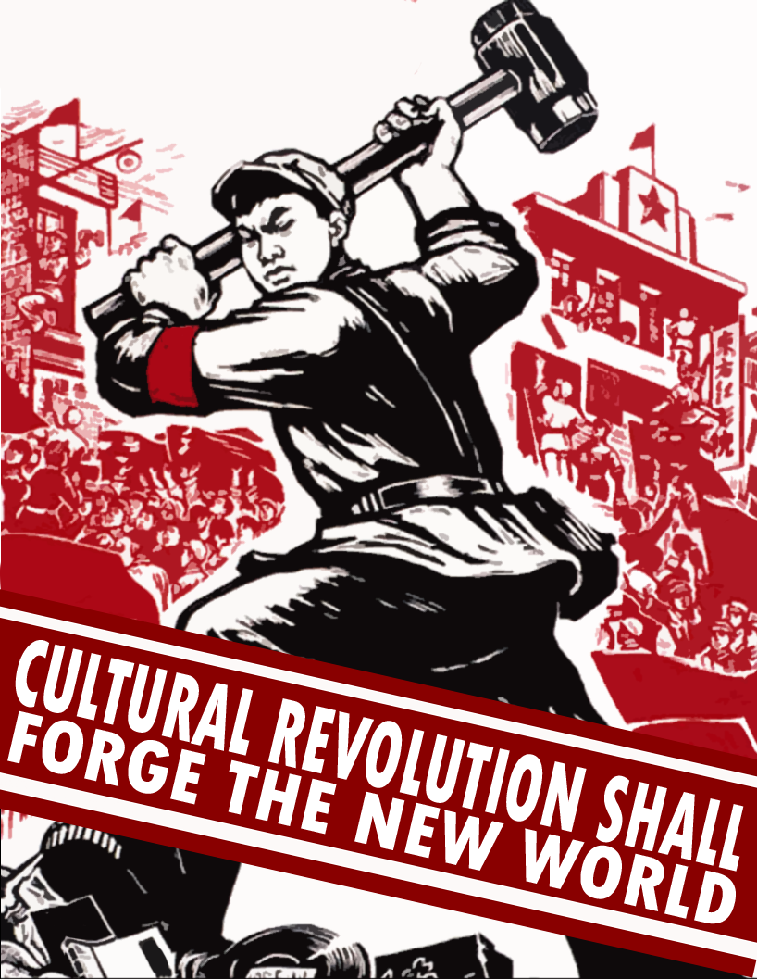
Vocab. Continued
Great Leap Forward – was a social and economic program to help transform China from a society based on agriculture to one centered on industrialization and collectivization
Cultural Revolution – social program created by Mao Zedong to rid China of its reliance on the past and dependence on Western influence.

Slide 6
Class Discussion
What is the main idea of this philosophy?
What are the positive attributes of this philosophy?
What are the negative aspect of this philosophy?

Slide 7
Discussion Continued
What is the main idea of this philosophy?
What are the positive attributes of this philosophy?
What are the negative aspect of this philosophy?

Slide 8
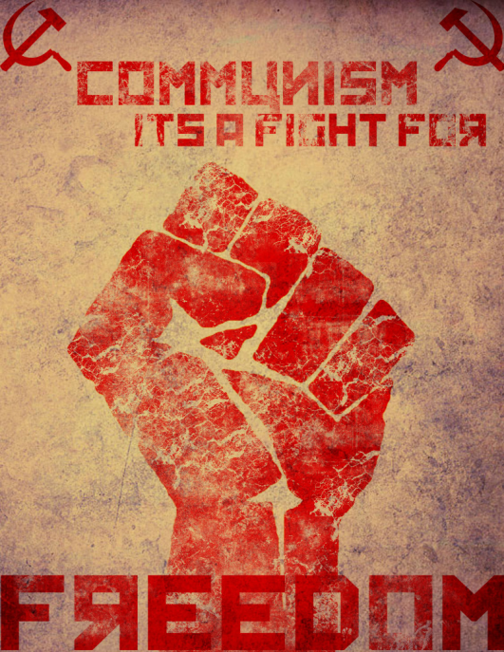
Matching Group Work
In groups Match Cards
Democracy
Communism under Dictators

Slide 9
Work Time ☺
Individually using IR-15
Complete IR-14/16/17

