Slide 1
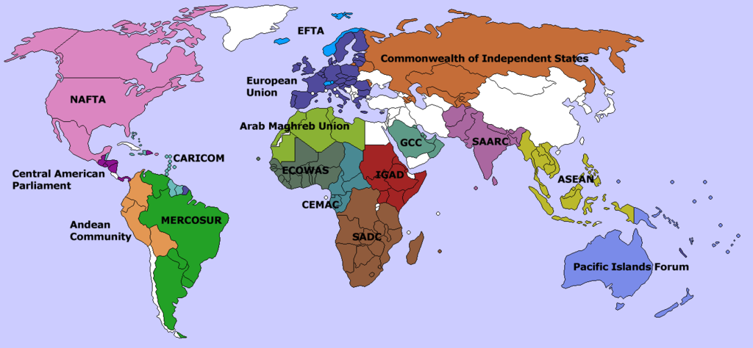
Political Geography & Globalization
Unit 6 Lesson 5
Supranationalism

Slide 2
Essential ?’s
What do the United Nations (UN), European Union (EU), North American Free Trade Agreement (NAFTA), and Association of Southeast Asian Nations (ASEAN) all support or promote?

Slide 3
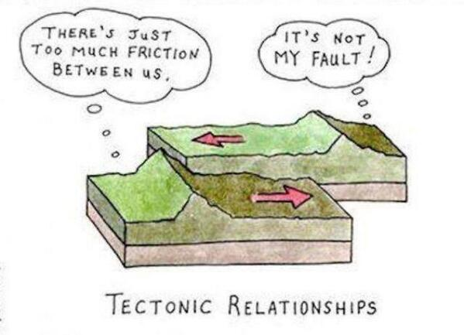
Map Items on SIM
Germany
Russia
United Kingdom
France
United States
Canada
Mexico
Indonesia
Malaysia
Philippines
Singapore
Thailand
Burma
Brunei
Cambodia
Laos
Vietnam

Slide 4
Vocabulary
Supranationalism – concept whereby a collection of countries is united by similar political and/or economic goals.
United Nations (UN) – established Oct. 24, 1945, currently has 193 members, and was formed with the purpose of overcoming intolerance, deception, and aggressive military behavior in the self-interest of rouge nations.
Treaty of Maastricht – signed 1993 by 12 European states creating a single economy for all member nations.
European Union (EU) – created by Maastricht Treaty, with 28 member countries representing more than 500 million people

Slide 5
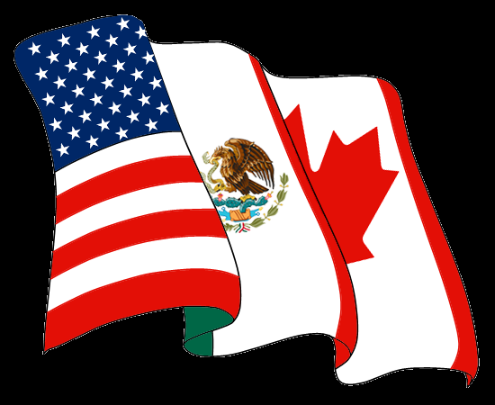
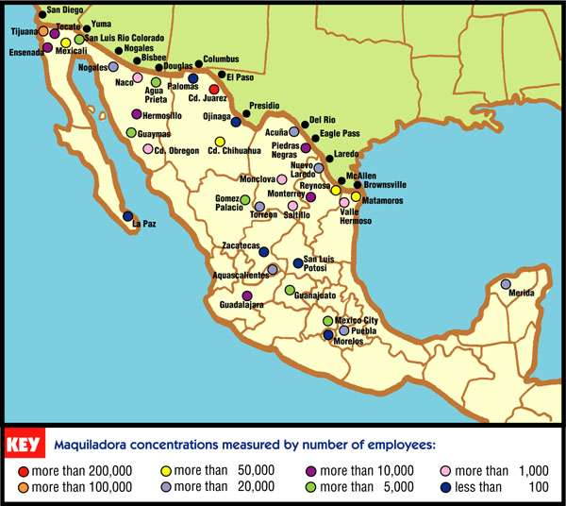
Vocab. Continued
Euro – common currency of the European Union
North American Free Trade Agreement (NAFTA) – 1994 Canada, USA, and Mexico agreed to abolish all tariffs between the 3 countries
Maquiladoras – foreign owned companies in the border cities of Mexico
Association of Southeast Asian Nations (ASEAN) – 1967 composed of Indonesia, Malaysia, the Philippines, Singapore, and Thailand. Foundation focuses on political-security community, economic community, and socio-cultural community

Slide 6
What’s in Common??

Slide 7
Individual Work
Complete IR-23 using reading from IR-24&26

