Slide 1
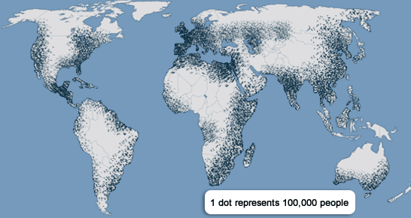
Population and Migration
Unit 5 Lesson 2
Population Density & Distribution

Slide 2
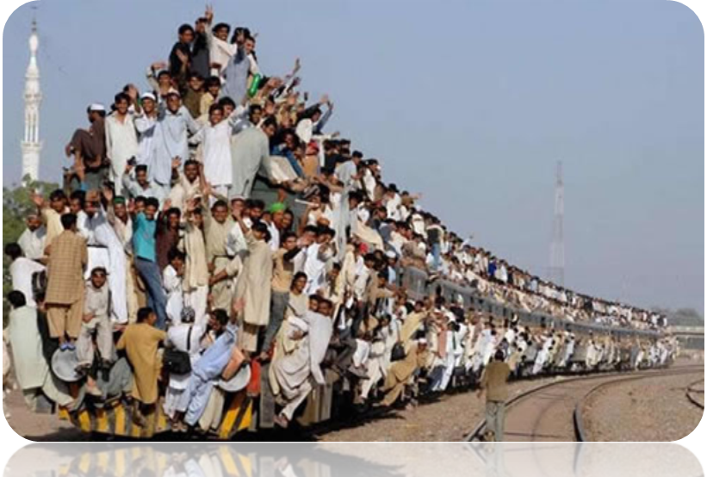
Essential ?’s
What is the difference between population density and population distribution?
Why is agricultural density a more relevant statistic than population density?

Slide 3
No Map Items

Slide 4
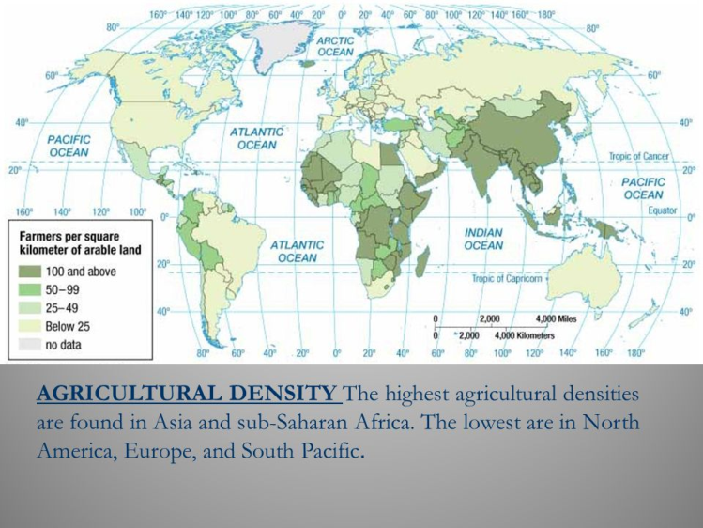
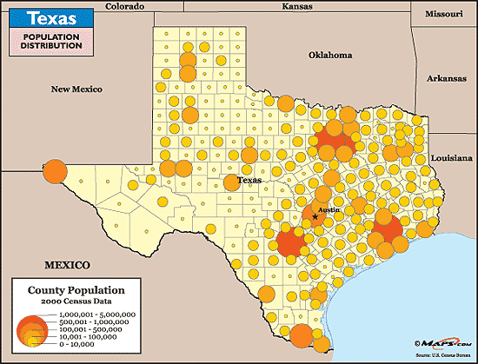
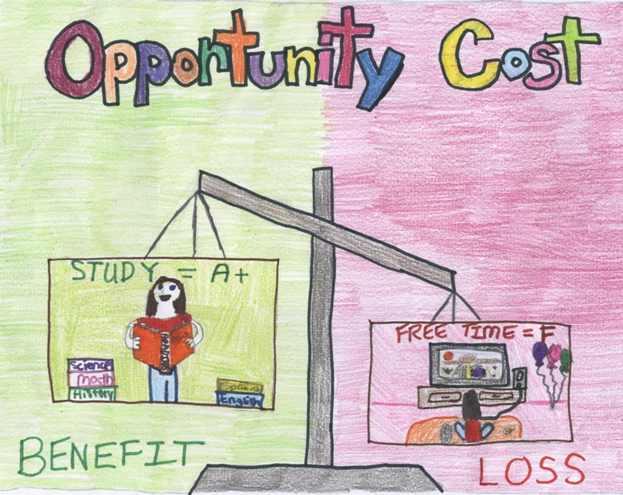
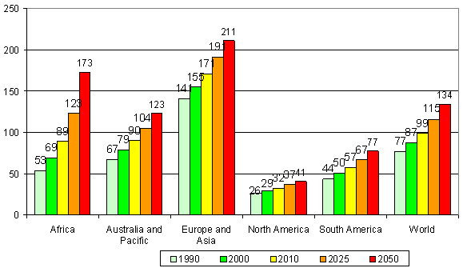
Vocabulary
Population Density – # of people divided by land area.
Population Distribution – arrangement of people within a predefined area.
Agricultural Density – # of farmers per unit of arable land.
Physiologic Density – # of people per unit of arable land.
Opportunity Cost – the $ that must be given up to acquire something else
Like spending $ on Jordan takes away from Doritos ☺ get it!

Slide 5
Think – Pair - Share
Think about a time in your life when you felt you were in a crowded situation or room.
What was your experience like?
What were your thoughts about the situation?
What do you think the population density of this classroom is?

Slide 6
Work Time ☺
Complete IR-6
Using Reading from IR-7

Slide 7
Journal Writing – Turn Writing into Basket
Describe the impact that population distribution may have on a country’s standard of living. (Include ideas about arable land, agricultural density, & physiologic density.)

