Slide 1
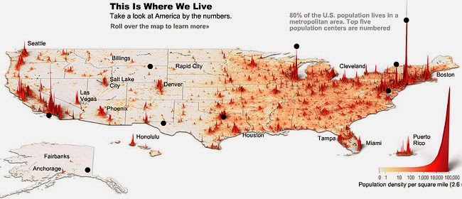
Population & Migration
Unit 5 Lesson 3
Population Clusters

Slide 2
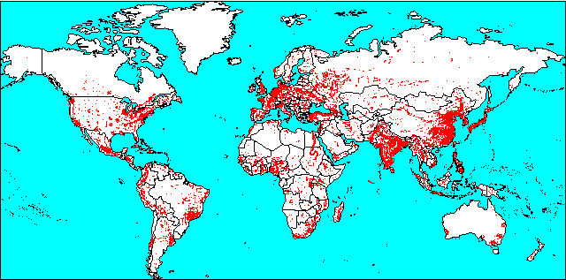
Essential ?’s
Where are the major population clusters in the world located?
What are a few unique cultural characteristics of each population cluster?

Slide 3
Map Items on SIM
Afghanistan
Pakistan
India
Bangladesh
Sri Lanka
China
Japan
South Korea
United Kingdom
France
Belgium
Netherlands
Germany
Northeast North America
Washington, DC.
To Boston
To Milwaukee
To Toronto
To Quebec City
Himalaya Mountains
Hindu Kush Mountains
Arabian Sea
Indian Ocean
Bay of Bengal
Huang e He River
Yangtze River
East China Sea
Yellow Sea
South China Sea
North Sea
Northern European Plain
Alps

Slide 4
No Vocab. ☺

Slide 5
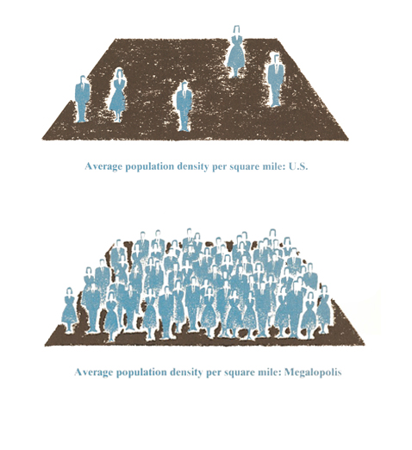
World Population Video Discussion
https://www.youtube.com/watch?v=khFjdmp9sZk
What areas of Earth had the largest population during most of the video?
In what areas of Earth did you notice little population concentration?
When did the population of the world start to explode, or grow rapidly? What caused this growth?

Slide 6
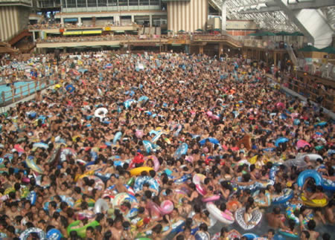
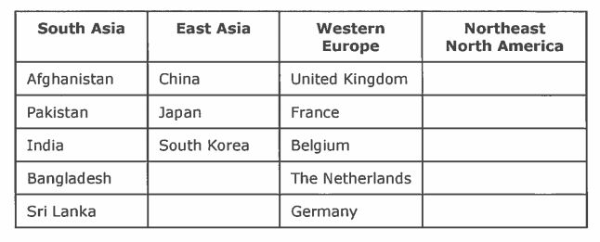
Group Work ☺
In groups complete IR-9
Using atlas label the following
Why do you think these places are the most densely populated regions?
What problems might people in these places experience?
Color:
H2O – Blue
S. Asia – Orange
E. Asia – Red
W. Europe – Purple
NE & N America - Green
Greenland
United States of America
Canada

Slide 7
Work Time
Complete IR-10 & IR-12
Using Reading from IR-11

Slide 8
Writing Time – Turn Into Basket
In paragraph format respond to the following questions:
What causes population clusters to develop?
What consequences might occur as a result of population clusters?
What policies might governments establish to solve problems created by population clusters?

