Slide 1
Population & Migration
Unit 5 Lesson 4
Population Pyramid

Slide 2
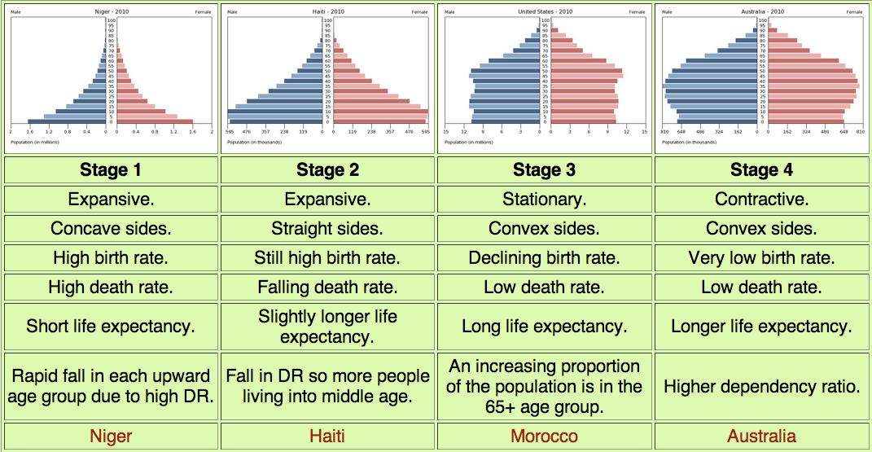
Essential ?’s
What are the characteristics of the rapid growth, slow growth, and negative growth population pyramids?

Slide 3
Map Items on SIM
Ethiopia
United States

Slide 4
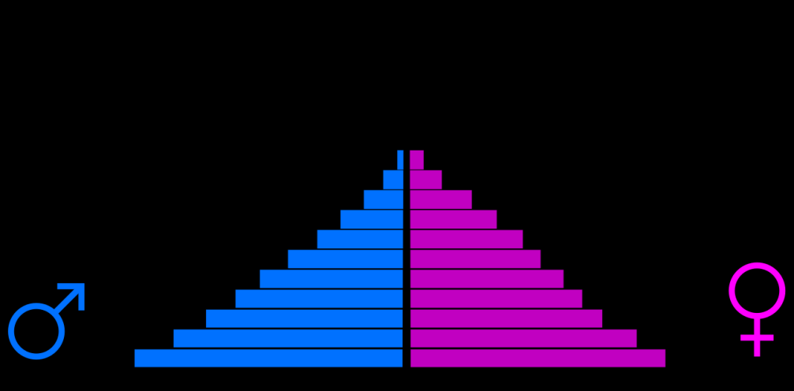
Vocabulary
Population Pyramid – a bar graph that shows the proportions of men and women in different age groups.
Rapid Population Growth – will have a population pyramid with a wide base and a pointed tip.
Ex. Ethiopia, life expectancy not very high
Slow Population Growth – pyramid is wide and stable and looks more like rectangle
Ex. United States, level of economic growth sustains a longer than average life.
Negative Population Growth – (Zero Population Growth) – pyramid inverted, older people outnumber younger
Ex. Italy

Slide 5
Class Discussion
What do the two sides of the graph indicate?
What do the numbers on the left side of the graph indicate?
What does the horizontal axis measure?
What conclusions can you draw about the population of the world based on this graph?

Slide 6
Work Time ☺
Complete IR-14 & IR-16
Using reading from IR-15

Slide 7
Writing Time– Turn into Basket
What role do demographers play in the study of population?
How can population pyramids help decision-makers?

