Slide 1
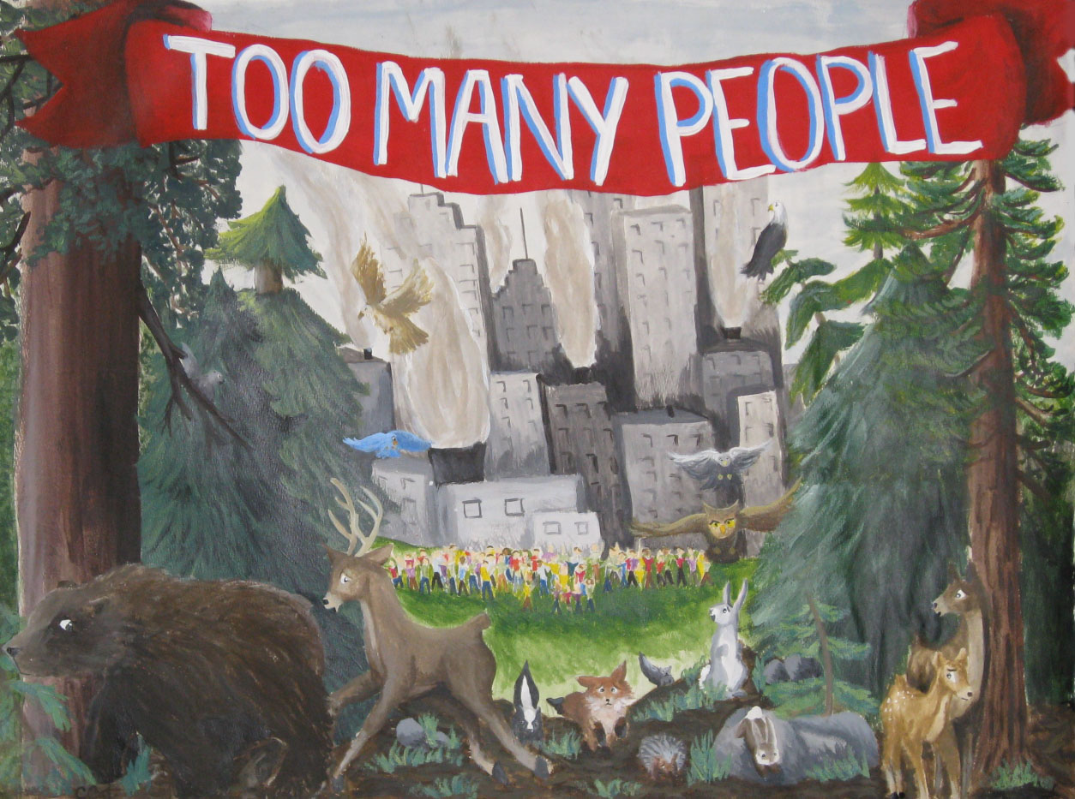
Population & Migration
Unit 5 Lesson 6
Population Projections and Trends

Slide 2
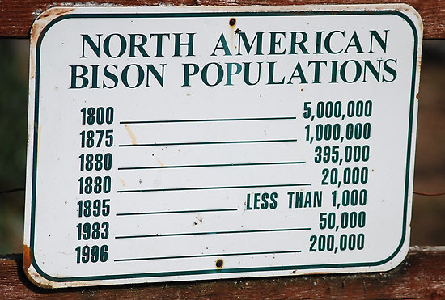
Essential ?’s
What social problems are caused by the doubling time of the global population?
How are the government’s population policies in China and Kenya similar and different?

Slide 3
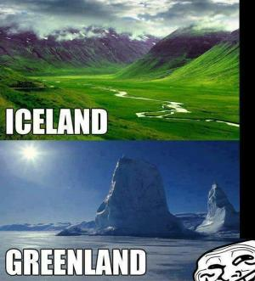
Map Items on SIM
China
India
United States
Russia
Haiti
Cambodia
Thailand
Zimbabwe
Botswana
Kenya

Slide 4
Vocabulary
Doubling Time – the amount of time it takes for a given population to double based on the annual growth rate.

Slide 5
Individual work
Complete IR-23:
Check the appropriate box and justify your response in the Explanation column.
Read IR-25 to complete the Notes column.

Slide 6
Group Work
In groups complete IR-24 using given research supplies.

Slide 7
Work Time ☺
Read IR-26 & IR-27
Then Complete Venn Diagram on IR-28
Finally answer Multiple Choice from IR-29

