Slide 1
The Geographer’s Eye
Unit 1 Lesson 2
Latitude & Longitude

Slide 2
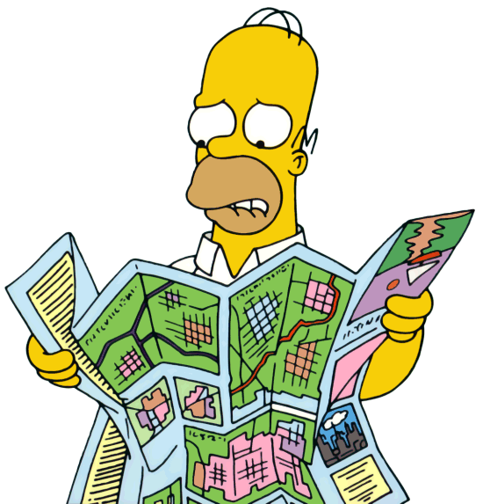
Essential ?
How do you use latitude and longitude to read map?

Slide 3
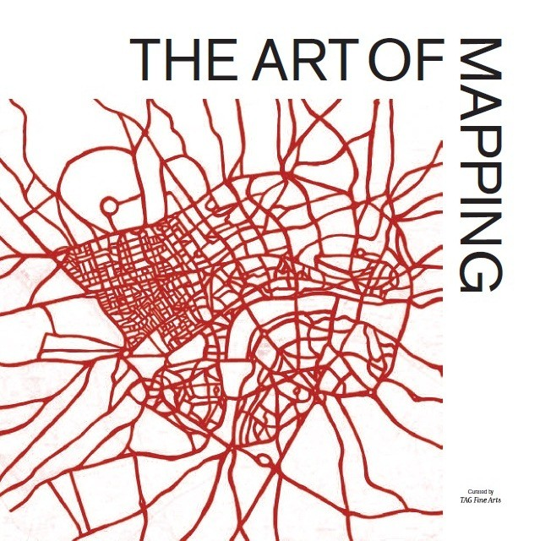
Map Items – Student Interactive Map
Tokyo
Phnom Penh
Singapore
Mumbai
St. Petersburg
Berlin
Paris
Khartoum
Lagos
Cape Town
Bogota
Tijuana
Vancouver
Houston
New York City

Slide 4
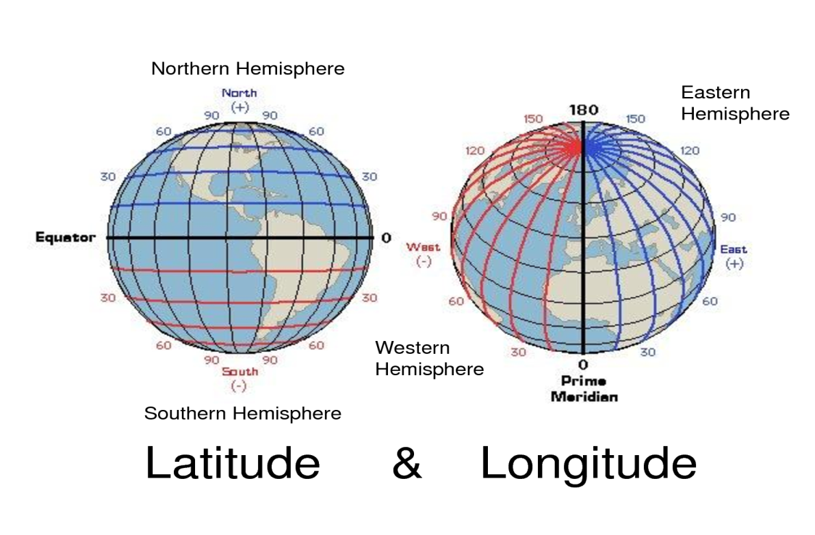
Vocabulary
Map – flat representation of Earth, or a portion of it.
Latitude – imaginary horizontal lines, running East & West, parallel to the equator, and measuring North & South of equator.
Longitude – imaginary vertical lines, running North & South, measuring distances East & West of the Prime Meridian.
Hemisphere – half a sphere or object.

Slide 5
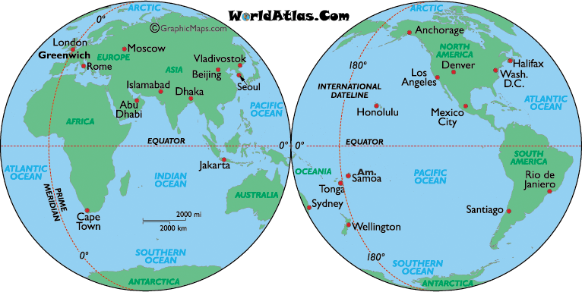
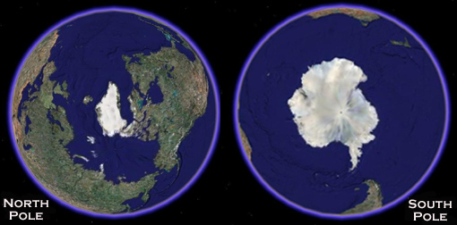
Vocab. Continued
Equator – measurement of 0* N/S, where the sun hits the Earth most directly.
Tropic of Cancer/Capricorn – where colder air descends back to Earth
Cancer – 23* N
Capricorn – 23* S
North/South Pole – farthest away from equator
North pole – 90* N
South pole – 90* S
Prime Meridian – 0* E/W
International Date Line – the opposite side of Earth from the Prime Meridian, measures at 180* E/W

Slide 6
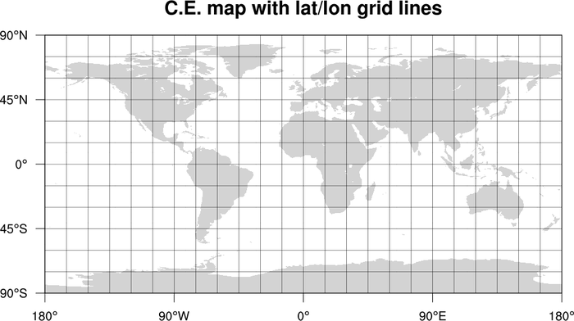
What is this???
Where have you seen something like this before?
Why would this graphic be helpful?

Slide 7
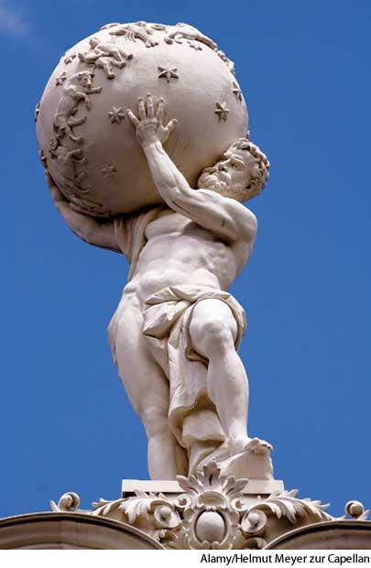
Practice
Working in pairs, Complete IR-5 using an Atlas or Map from textbook
Answers ?’s as a Class Discussion after IR-5 complete
What patterns were evident about the spatial relationships between these cities?
What do most of these cities share in common about their physical location?
What words could be used to name the physical location that the cities share in common?

Slide 8
Work Time ☺
Complete IR-6
Using reading from IR-7

