Slide 1
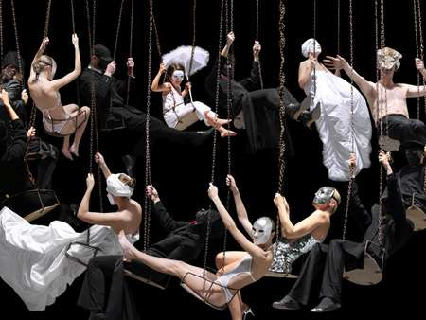
The Human Mosaic
UNIT 4 LESSON 7
CULTURAL CUSTOMS

Slide 2
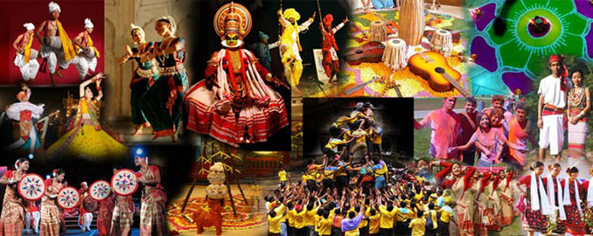
Essential ?’s
How does the caste system of India relate to the social classes of the United States?
How might government policies influence cultural customs or practices?

Slide 3
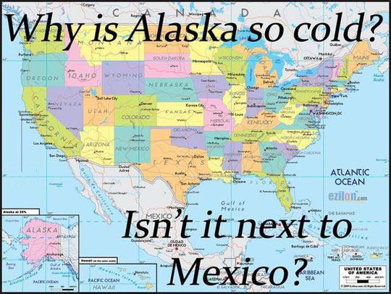
Map Items on SIM
India
Saudi Arabia
Kuwait
Afghanistan
Japan
United States
Ethiopia
China
Mexico
Thailand
South Korea

Slide 4
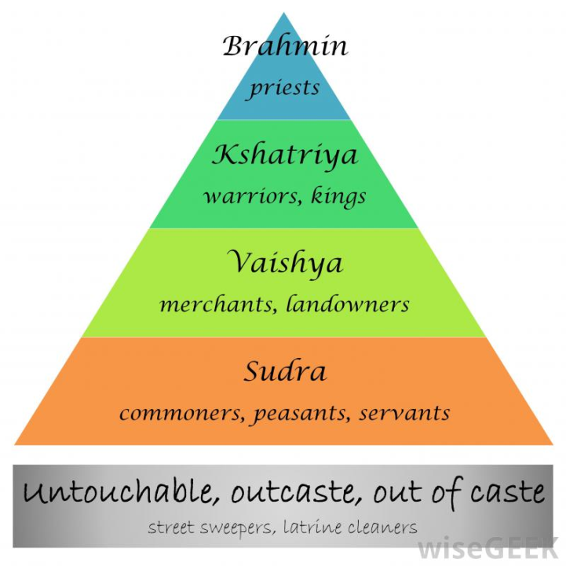
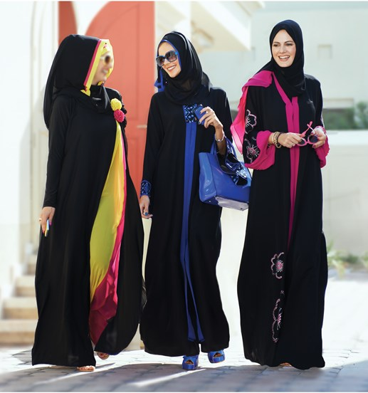
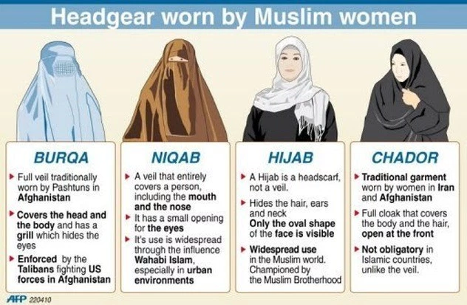
Vocabulary
Caste System – Social class system in India that also divided labor.
Abaya – A loose full-length black garment that covers all body parts. Saudi Arabia
Darrah – A more traditional dress that extends from the neckline to the ankles in a straight line. Kuwait
Burqa – Like the Abaya but includes a face covering, leaving a small opening for the eyes. Required by Taliban, Afghanistan

Slide 5
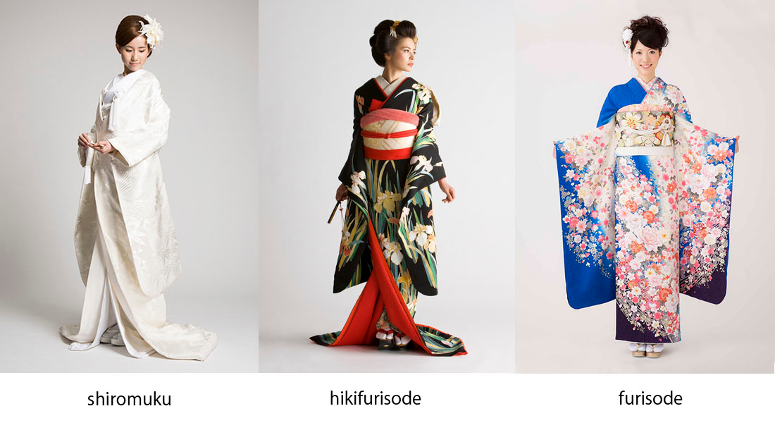
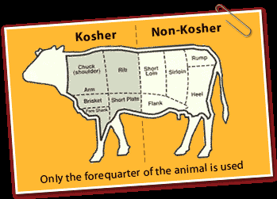
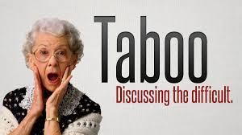
Vocab. Continued ☺
Kimono – Originally meaning “clothing”, Traditional Japanese clothes worn for special occasions, can also indicate political class.
Taboo – Something that society deems should be prohibited or avoided.
Kosher – Hebrew word for “good or proper”. Jews believe food must be properly prepared according to certain rituals.

Slide 6
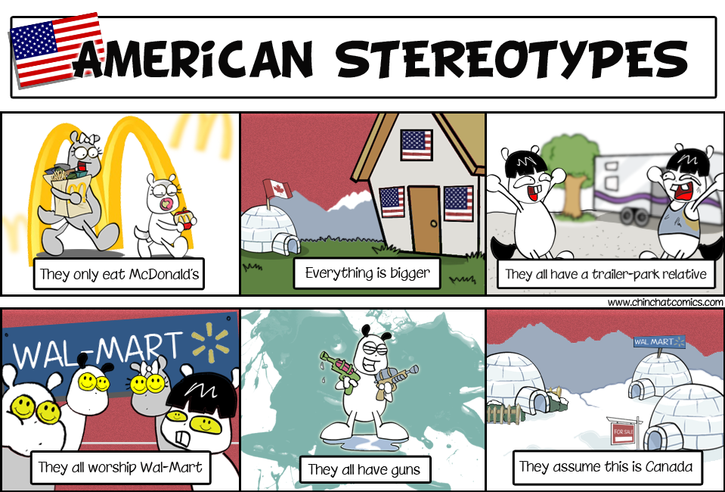
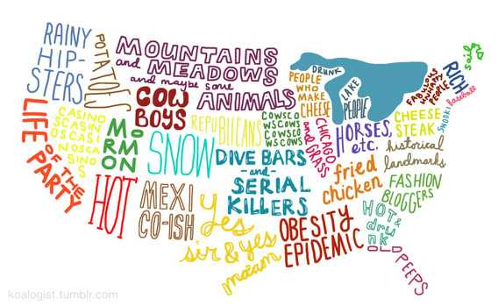
Time to Draw!
Draw what an American looks like.
What characteristics did you include in your picture?
Generally speaking, how does the “average American” look different from the “average person” from another region of the world?

Slide 7
Group Writing
In 1 paragraph, describe the culture of the United States.
Select a member of your group to read aloud to the class.

Slide 8
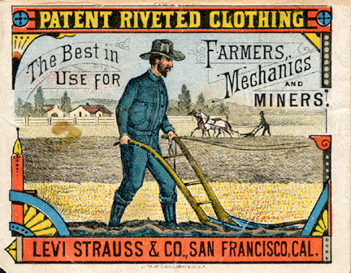
IR-33 Geography of Blue Jeans Discussion
How are Blue Jeans an example of American Culture?
How would your life be different if you did not have access to denim?
What does clothing indicate about the value of a culture?

Slide 9
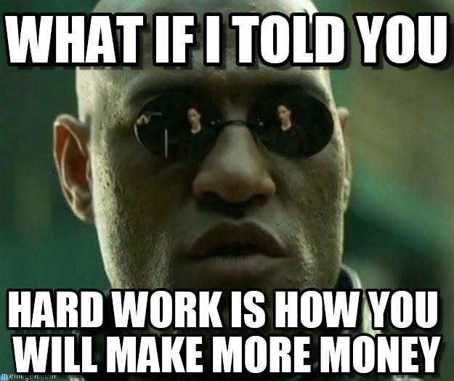
Time for Work!
Complete IR-31 while using reading from IR-32 & IR-34
Work individually!

