Slide 1
Economic Geography & Development
Unit 2 Lesson 2
Economic Activities

Slide 2
Essential ?’s
What are the 4 categories of economic activities?
What would the effects on a country’s economy be if it did not have a balance between its economic activities & it’s environment?
What role does technology play in a country’s ability to engage in various economic activities?

Slide 3
No Map Items ☹

Slide 4
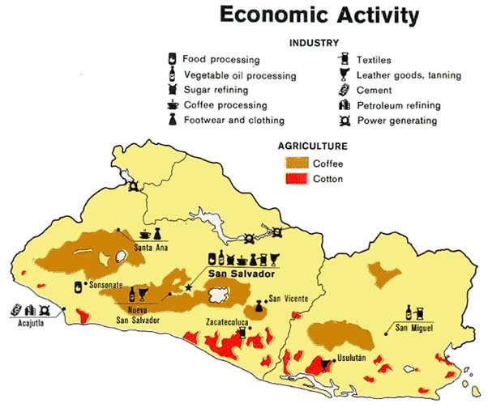
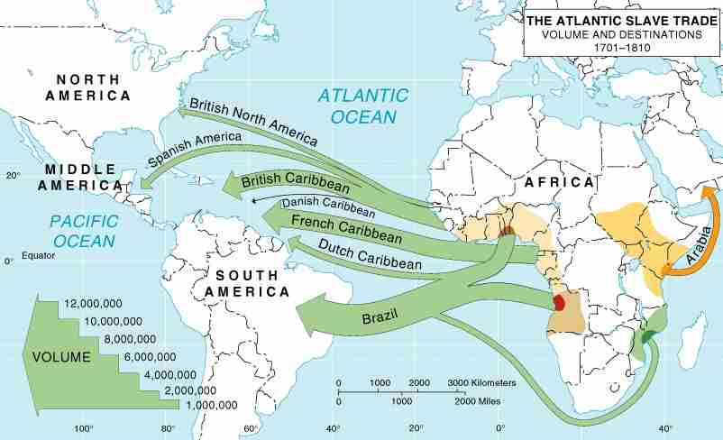
Economic Geography
Patterns of resource distribution & economic policies humans create to analyze patterns of development & industry on local, regional, & global scales.

Slide 5
Economic Activities
Different types of jobs people do to earn $ in society.

Slide 6
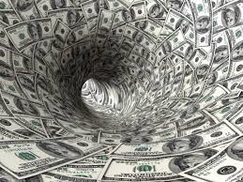
Complete Chart with PPT.
IR-1

Slide 7
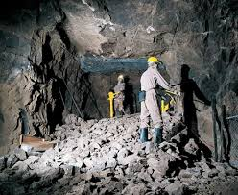
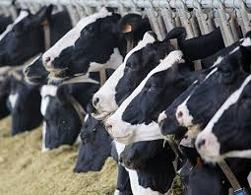
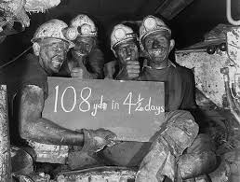
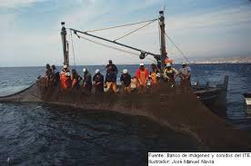
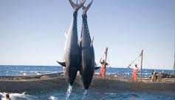
Primary Sector
Workers who harvest resources. Ex. Farmers, Miners, & Fisherman.

Slide 8
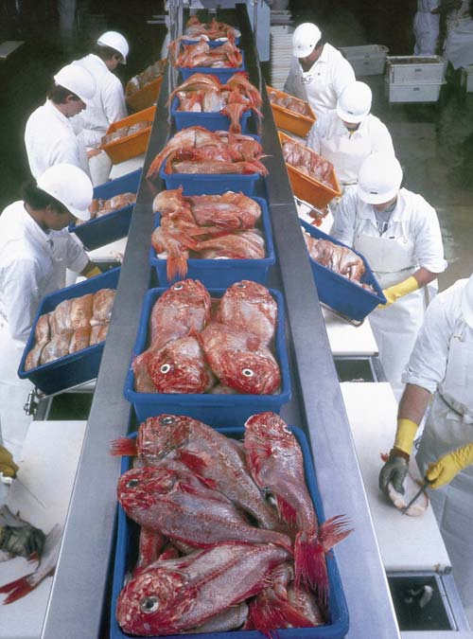
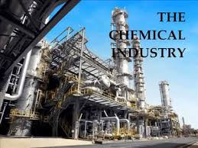
Secondary Sector
Workers who convert natural resources into a product that human beings can use or consume. Ex. Food manufacturing plants, Oil refineries, & Automobile assembly plants.

Slide 9
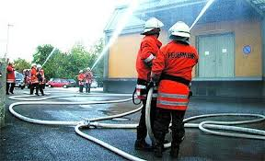
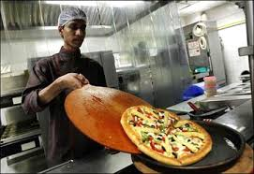
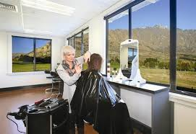
Tertiary Sector
Workers who provide services. Ex. Doctors, Teachers, Police, Grocery store clerks, Garbage men, Waiters.

Slide 10
Quaternary Sector
Workers who gather, create, process, & use information & capital. Ex. Finance, Insurance, & Information Services.

Slide 11
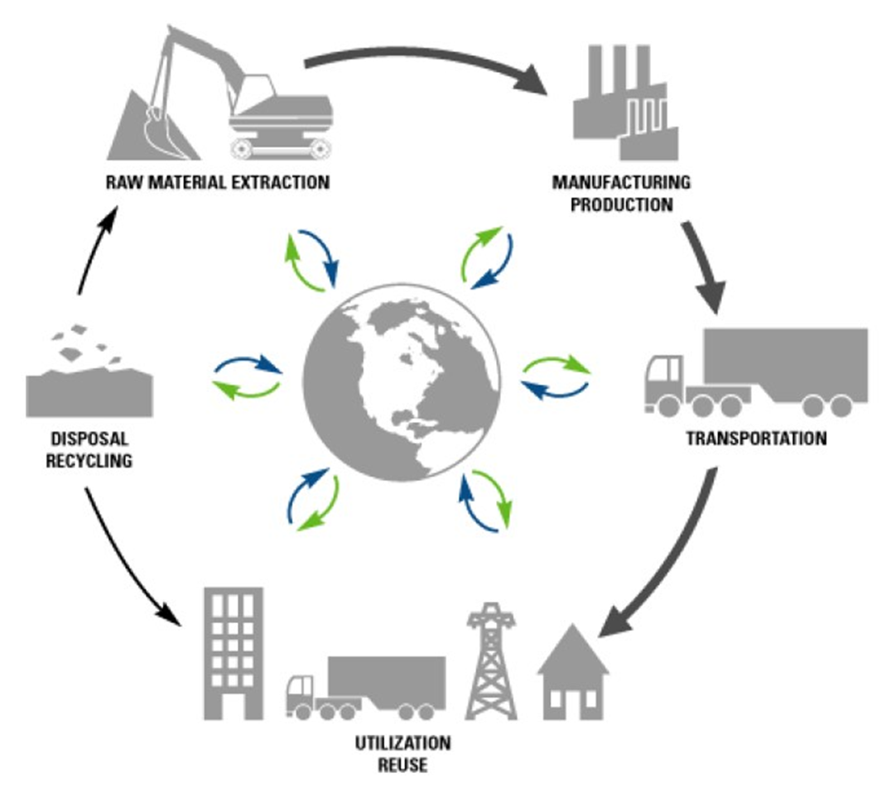
Geographer Notes – In Journal
Summarize the connection between levels of development in economic activities: primary, secondary, tertiary, and quaternary. Why is it important to have an integrated economy?

