Slide 1
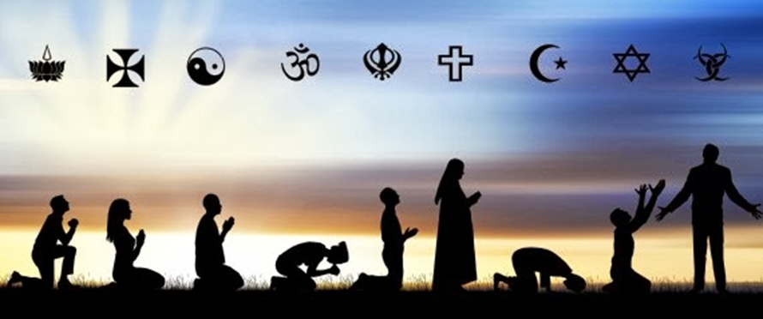
NEW LEFT HAND SIDE
VOLUME 4 LESSON 5
WHAT IS RELIGION?
Title: Religion
Date: 1/24/2017

Slide 2
OBJECTIVES
Content Objective: Describe, compare and contrast major world religions including animism, Buddhism, Christianity, Hinduism, Islam, Judaism, and Sikhism, and their spatial distribution through the world.
Language Objective: I will discuss, write about, and identify different aspects of world religion using the vocab terms:

Slide 3
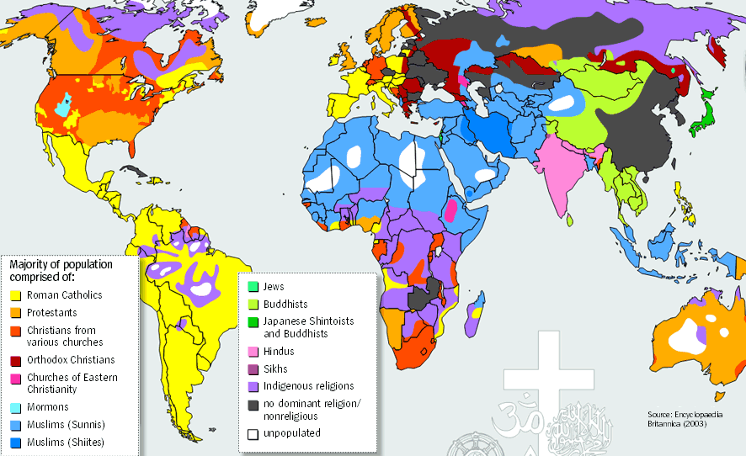
ESSENTIAL ?’S
What are the differences between universal and ethnic religion?
What similarities are there in the diffusion of religions from their hearth?

Slide 4
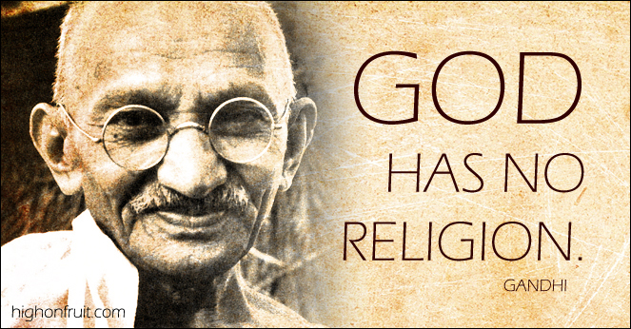
MUSIC ANALYSIS
https://www.youtube.com/watch?v=T-dM6ZpOvEE
What are your opinions on religious expression?
How did this song make you reflect on your own religious beliefs?
Are some religious beliefs universal?

Slide 5
PRE-READING QUESTIONS
Look at the Anticipation Guide
Circle A for Agree
or D for Disagree
for each of the statements

Slide 6
VOCABULARY
Religion – set of beliefs attempting to answer life’s ultimate questions:
Why are we here? What happens after death?
Atheists – Belief in no God
Monotheist – belief in 1 God
Polytheist – Belief in many Gods
Agnostic – Belief in a high power, but no affiliation to a religion
Universal Religion – try to appeal to any and all people
Ethnic Religion – Based on a set of physical characteristics and have limited distribution patterns

Slide 7
VOCABULARY - CHRISTIANITY
Christianity – 33 AD, follow the teachings of Jesus Christ and God
Sacred Space – Religious grounds or church
Church – building for worship
Basilica – Catholic housing of the Pope
Cathedral – Catholic housing of a bishop
Holy bible – Sacred text of Christianity
Where? – Jerusalem
Founder? - Jesus and 12 Disciples
Deity – God, Jesus, Holy Ghost

Slide 8
VOCAB - ISLAM
Islam – 622 AD, followers of the prophet Mohammad and the God Allah.
Muslims – followers of Islam – translation “one who submits”
Sunni – Majority branch of Islam found all over
Shi’a – minority branch found mainly in Iran
Mosque – building of worship and prayers
Qur’an – sacred texts of Islam
Suras – chapters of the Koran
Hajj – Religious pilgrimage
Ramadan – religious time of fasting
Deity – Allah, Mohammad
Home – Mecca

Slide 9
VOCAB - ISLAM
5 pillars of faith
Shahadah: sincerely reciting the Muslim profession of faith.
Like a pledge of allegiance
Salat: performing ritual prayers in the proper way five times each day.
Facing Mecca
Zakat: paying an alms (or charity) tax to benefit the poor and the needy.
Offering
Sawm: fasting during the month of Ramadan.
Cannot eat during Daylight
Hajj: pilgrimage to Mecca.

Slide 10
VOCAB - JUDAISM
Judaism – 2000 BC, one of the oldest religions in the world, follows God of Abraham
Promised Land – Land near Israel that was “promised” to Jews by God
Orthodox Jew – most traditional representation of Jewish faith
Reform Jew – most liberal “open-minded” Jews
Conservative Jew – in the middle, follows some old guidelines and some new
Ethical Monotheism – Revolutionary belief of ONE God
Torah – Sacred Book handed down from Moses
Talmud – Written history of Judaism
Bar or Bat Mitzvah – Boys and Girls become sons and daughters of the Commandments and vow to obey
Deity – God
Founder – Abraham
Rules – 10 commandments

Slide 11
VOCAB - BUDDHISM
Buddhism – 500 BC, originally a branch off of Hinduism, found in SE Asia, no god, teacher or leader is Buddha
4 Nobel truths –
1) Life is suffering, 2) Suffering is from desire, 3) stop suffering by ending desire, 4) follow the 8fold path to enlightenment
Eight Fold Path – Rules to live by, similar to 10 commandments
Tripitaka – Sacred text of Buddhists
Reincarnation – rebirth of the soul into another life form
Meditation – Silent period of reflection or prayer
Deity – Umm, kinda none
Founder – Buddha (Siddhartha Gautama)
Dalai Lama – Political Leader of Buddhism

Slide 12
VOCAB - HINDUISM
Hinduism – 1500 BC, started in India, 13% of the worlds population, polytheistic, caste system
Brahma – The creator, main God, the bull
Shiva – The destroyer, God of death
Vishnu – The preserver, God of rebirth
Vedas – sacred text, collection of works passed down from the Gods
Dharma – following your path and doing your job well (or else)
Karma – actions you take toward others (golden rule)

Slide 13
CASTE SYSTEM

Slide 14
VOCAB - SIKHISM
Sikhism – 1650 AD, smallest universal religion, disciples of the Guru, monotheistic
Guru – religious leader that has received divine inspiration
Guru Granth – Sacred Text, collection of poems and stories to give instructions on how to live life
Tenets of Sikhism – Rules to live by
The Creator – Their Deity, Similar to Brahma (the God of Hindus)

Slide 15
CLASS DISCUSSION
Where have you seen these before?
What questions do you have about these pictures?

Slide 16
AS A CLASS
Using IR-23 (reading) and your Chart
Fill in IR-22: Outline summary of 6 Major Religions

Slide 17
INDIVIDUAL WORK
Using IR-23 complete:
IR-24 – Religious Table
IR-25 & 26 – Venn Diagrams
IR-27 Multiple Choice

